Slide 1
Biology and Chemistry
Chemical Biology research uses the tools of chemistry and synthesis to understand biology and disease pathways at the molecular level.

Slide 2
Advanced Biological Chemistry interests include diverse topics such as
nucleic acids,
DNA repair,
bioconjugate chemistry,
peptides and peptidomimetics,
glycoscience,
biomolecular structure and function,
and biological catalysis.

Slide 3
Biophysical Chemistry represents the union of Chemistry, Physics, and Biology using a variety of experimental and theoretical approaches to understand the structure and function of biological systems.
A number of technologies to improve (bio)chemical measurements are under development among them is separation.

Slide 4
Chemical separations remain a core tool in analytical chemistry involved in anything from biological research to pharmaceutical industry to environmental analysis.
The continued evolution of separation methods such as chromatography and electrophoresis is driven by the need for analysis of complex mixtures on smaller scale in shorter times.

Slide 5
A particular emphasis is on improving separation methods so that analysis can be performed on extremely small samples, increase the speed of separation analysis to sub-second levels for rapid, high-throughput by using a variety of spectroscopic detectors, applications to a variety of topics including metabolomics, proteomics, glycomics, neuroscience, and pharmaceuticals are being explored.

Slide 6
What Is HPLC?
Basic Principles
Notes:
Fundamentally, chromatography is a technique used to separate the components contained in a sample.
Above all, high performance liquid chromatography (HPLC) is a type of chromatography that, because of its wide application range and quantitative accuracy, is regarded as an indispensable analytical technique, particularly in the field of organic chemistry. It is also widely used as a preparation technique for the isolation and purification of target components contained in mixtures.
An overview of HPLC, from the basic principles of chromatography to the characteristics of HPLC itself, is presented here.

Slide 7
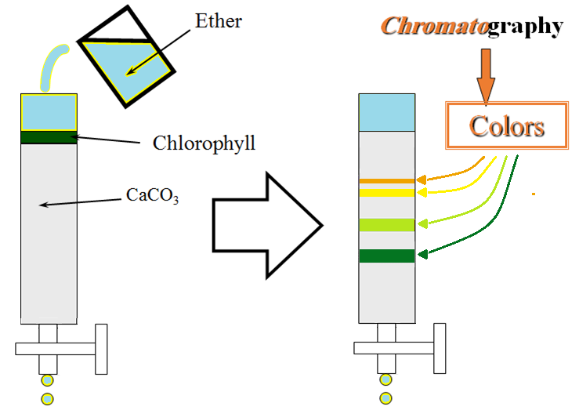
Invention of Chromatography by M. Tswett
Notes:
The Russian-Polish botanist M. Tswett is generally recognized as the first person to establish the principles of chromatography.
In a paper he presented in 1906, Tswett described how he filled a glass tube with chalk powder (CaCO₃) and, by allowing an ether solution of chlorophyll to flow through the chalk, separated the chlorophyll into layers of different colors. He called this technique “chromatography”.

Slide 8
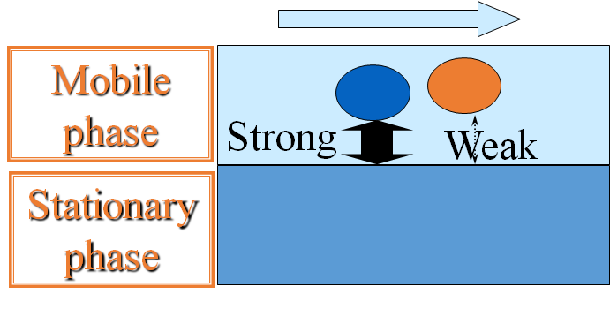
Mobile Phase / Stationary Phase
A site in which a moving phase (mobile phase) and a non-moving phase (stationary phase) make contact via an interface that is set up.
The affinity with the mobile phase and stationary phase varies with the solute. → Separation occurs due to differences in the speed of motion.
Notes:
In chromatography, the field of separation is divided into two phases. One phase, called the “stationary phase”, does not move. The other phase, called the “mobile phase”, moves at a constant speed in one direction.
The stationary phase and mobile phase make contact via an interface. They do not intermingle, and are kept in a steady state of equilibrium.
In the river analogy, the riverbed corresponds to the stationary phase and the flowing water corresponds to the mobile phase.
Let us suppose that some substance has been introduced into the flow of the mobile phase and led to the separation site. If this substance contains a component that is only weakly attracted by the stationary phase and a component that is strongly attracted by the stationary phase, the former component will be pulled along quickly by the flow of the mobile phase whereas the latter component will stick to the stationary phase and only move slowly.
In this way, differences in the properties of the various components contained in the sample being analyzed give rise to differences in speed. This makes it possible to separate components from each other.
Incidentally, in the river analogy, the interaction that determines the speed of motion is based on gravity (and buoyancy in water). In chromatography, various physical and chemical properties, such as solubility and the degree of adsorption, determine the dynamics of separation.

Slide 9
Chromato-graphy / -graph / -gram /-grapher
Chromatography: Analytical technique
Chromatograph: Instrument
Chromatogram: Obtained “picture”
Chromatographer: Person

Slide 10
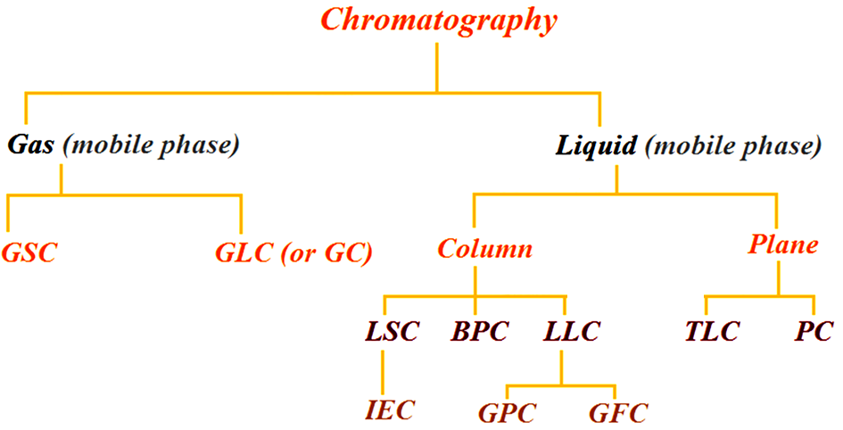
Chromatographic methods can be classified according to the types of mobile and stationary phases as follows:
Where:
GSC = gas-solid chromatography GLC = gas-liquid chromatography PC = paper chromatography
LSC = liquid-solid chromatography IEC = ion-exchange chromatography TLC = thin-layer chromatography
BPC = bond-phase chromatography EC = exclusion chromatography LLC = liquid-liquid chromatography
GPC = gel permeation chromatography GFC = gel filtration chromatography

Slide 11
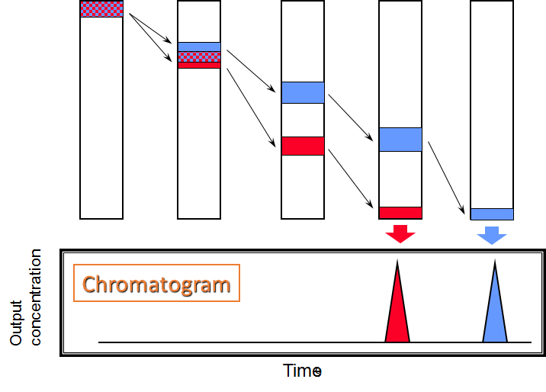
Separation Process and Chromatogram for Column Chromatography
Notes:
The separation process for column chromatography is shown in the above diagram.
After the eluent is allowed to flow into the top of the column, it flows down through the spaces in the packing material due to gravity and capillary action. In this state, a sample mixture is placed at the top of the column. The solutes in the sample undergo various interactions with the solid and mobile phases, splitting up into solutes that descend quickly together with the mobile phase and solutes that adsorb to the stationary phase and descend slowly, so differences in the speed of motion emerge. At the outlet, the elution of the various solutes at different times is observed.
A detector that can measure the concentrations of the solutes in the eluate is set up at the column outlet, and variations in the concentration are monitored. The graph representing the results using the horizontal axis for times and the vertical axis for solute concentrations (or more accurately, output values of detector signals proportional to solute concentrations) is called a “chromatogram”.

Slide 12
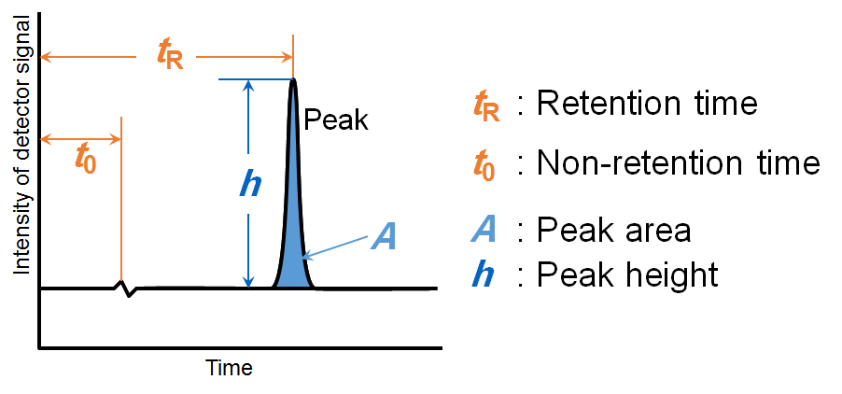
Chromatogram
Notes:
Usually, during the time period in which the sample components are not eluted, a straight line running parallel to the time axis is drawn. This is called the “baseline”.
When a component is eluted, a response is obtained from the detector, and a raised section appears on the baseline. This is called a “peak”. The components in the sample are dispersed by the repeated interactions with the stationary and mobile phases, so the peaks generally take the bell-shape form of a Gaussian distribution.
The time that elapses between sample injection and the appearance of the top of the peak is called the “retention time”. If the analytical conditions are the same, the same substance always gives the same retention time. Therefore, the retention time provides a means to perform the qualitative analysis of substances.
The time taken for solutes in the sample to go straight through the column together with the mobile phase, without interacting with the stationary phase, and to be eluted is denoted as “t₀”. There is no specific name for this parameter, but terms such as “non-retention time” and “hold-up time” seem to be commonly used.
Because the eluent usually passes through the column at a constant flow rate, t_{R} and t₀ are sometimes multiplied by the eluent flow rate and handled as volumes. The volume corresponding to the retention time is called the “retention volume” and is notated as V_{R}.
The length of a straight line drawn from the top of a peak down to the baseline is called the “peak height”, and the area of the raised section above the baseline is called the “peak area”.
If the intensities of the detector signals are proportional to the concentrations or absolute quantities of the peak components, then the peak areas and heights are proportional to the concentrations of the peak components. Therefore, the peak areas and heights provide a means to perform the quantitative analysis of sample components. It is generally said that using the peak areas gives greater accuracy.

Slide 13
From Liquid Chromatography to High Performance Liquid Chromatography
Higher degree of separation! → Refinement of packing material (3 to 10 µm)
Reduction of analysis time! → Delivery of eluent by pump → Demand for special equipment that can withstand
high pressures
The arrival of high performance liquid chromatography!
Notes:
In order to increase the separation capability of column chromatography, in addition to increasing the surface area of the stationary phase so that the interaction efficiency is increased, it is also necessary to homogenize the separation field as much as possible so that dispersion in the mobile and stationary phases is minimized. The most effective way of achieving this is to refine the packing material.
Refining the packing material, however, causes resistance to the delivery of the eluent to increase. This is similar to the way that water drains easily through sand, which has relatively large particles, whereas it does not drain easily through clay-rich soil, which has relatively fine particles.
Depending on gravity and capillary action would cause analysis to take a very long time to be completed, and the idea of delivering the eluent forcibly using a high-pressure pump was proposed. This was the start of high performance liquid chromatography.

Slide 14
Advantages of HPLC
High separation capacity, enabling the batch analysis of multiple components.
Superior quantitative capability and reproducibility.
Moderate analytical conditions.
Unlike GC, the sample does not need to be vaporized.
Generally high sensitivity.
Low sample consumption.
Easy preparative separation and purification of samples.

Slide 15
Fields in Which High Performance Liquid Chromatography Is Used
Biogenic substances
Sugars, lipids, nucleic acids, amino acids, proteins, peptides, steroids, amines, etc.
Medical products
Drugs, antibiotics, etc.
Natural products
alkaloid, terpenoid,
phenylpropanoid, polyketide, etc.
Food products
Vitamins, food additives, sugars, organic acids, amino acids, etc.
Environmental samples
Inorganic ions
Hazardous organic substances, etc.
Organic industrial products
Synthetic polymers, additives, surfactants, etc.
Notes:
HPLC is currently being used in a broad range of fields. In particular, in the field of biochemistry, it is widely used as an indispensable analytical technique.
From the perspective of an analytical instrument manufacturer, we observe that the industry that purchases the highest number of high performance liquid chromatographs is the pharmaceutical industry. It is said that the number of deliveries for this industry accounts for about 40% of the total. Although the number of deliveries to quality control departments is particularly high, it is also quite high for drug discovery and R&D departments.

Slide 16
HPLC Hardware
Solvent Delivery System,
Degasser,
Sample Injection Unit,
Column,
Column Oven,
Detector.
Notes:
The analytical instrument used to perform high performance liquid chromatography is called a “high performance liquid chromatograph”.
A high performance liquid chromatograph consists of several units. Here, in Part 1, I shall present all the units except the detector and data processor.

Slide 17
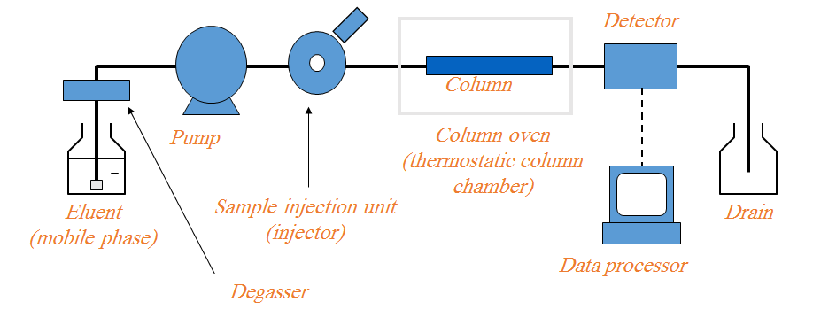
Flow Channel Diagram for High Performance Liquid Chromatograph
Notes:
A high performance liquid chromatograph differs from a column chromatograph in that it is subject to the following performance requirements.
Solvent Delivery Pump
A solvent delivery pump that can maintain a constant, non-pulsating flow of solvent at a high pressure against the resistance of the column is required.
Sample Injection Unit
There is a high level of pressure between the pump and the column; a device that can inject specific amounts of sample under such conditions is required.
Column
The technology for filling the column evenly with refined packing material is required. Also, a material that can withstand high pressures, such as stainless steel, is required for the housing.
Detector
Higher degrees of separation have increased the need for high-sensitivity detection, and levels of sensitivity and stability that can respond to this need are required in the detector.

Slide 18
Mobile Phase
Water
“Ultrapure water” can be used with confidence.
Commercial “distilled water for HPLC” is also acceptable.
Organic Solvent
HPLC-grade solvent can be used with confidence.
Special-grade solvent is acceptable depending on the detection conditions.
Care is required regarding solvents containing stabilizers (e.g., tetrahydrofuran and chloroform)
Notes:
Sometimes, powdered cuttings and organic dirts are present on new tubing. After connecting new tubing, be sure to rinse the flow channels. It is generally advisable to use alcohol-based solvents (e.g., 2-propanol) for rinsing. It is not necessary to use solvents of a particularly high purity for this purpose.
After rinsing the flow channels, prepare eluent and deliver it. For this, use solvent of as high a purity as possible.
The water prepared by an “ultrapure water system” can be used with confidence. In general, however, this level of purity is not always necessary. Purified water that has undergone a purification process consisting of at least two stages, such as reverse osmosis and ion exchange or ion exchange and distillation, is usually acceptable. Of course, commercial purified water specifically intended for HPLC may also be used.
HPLC-grade organic solvents can be used with confidence. In general, however, HPLC-grade solvents are a little expensive, and depending on the analytical conditions, it may be acceptable to use special-grade solvent.
Solvents such as tetrahydrofuran and chloroform contain additives, and this may cause problems in detection or separation. Of course, solvents containing additives are more stable, so, in some cases, it may be better to use such solvents as long as there are no problems with analysis. Therefore, decide whether or not to use solvents containing additives in accordance with the specific details of the analytical process.

Slide 19
SEVERAL COLUMN TYPES
can be classified as
Normal phase
Reverse phase
Size exclusion
Ion exchange

Slide 20
NORMAL PHASE
In this column type, the retention is governed by the interaction of the polar parts of the stationary phase and solute. For retention to occur in normal phase, the packing must be more polar than the mobile phase with respect to the sample.

Slide 21
REVERSE PHASE
In this column the packing material is relatively nonpolar and the solvent is polar with respect to the sample.
Retention is the result of the interaction of the nonpolar components of the solutes and the nonpolar stationary phase.
Typical stationary phases are nonpolar bonded hydrocarbons (such as C18, C8, etc.) and the solvents are polar aqueous-organic mixtures such as methanol-water or acetonitrile-water.

Slide 22
SIZE EXCLUSION
In size exclusion the HPLC column is consisted of substances which have controlled pore sizes and is able to be filtered in an ordinarily phase according to its molecular size. Small molecules penetrate into the pores within the packing while larger molecules only partially penetrate the pores. The large molecules elute before the smaller molecules.

Slide 23
ION EXCHANGE
In this column type the sample components are separated based upon attractive ionic forces between molecules carrying charged groups of opposite charge to those charges on the stationary phase. Separations are made between a polar mobile liquid, usually water containing salts or small amounts of alcohols, and a stationary phase containing either acidic or basic fixed sites.

Slide 24
Basic Settings for Eluent Used in Reversed Phase Mode
Water (buffer solution) + water-soluble organic solvent
Water-soluble organic solvent: Methanol Acetonitrile Tetrahydrofuran etc.
The mixing ratio of the water (buffer solution) and organic solvent has the greatest influence on separation.
If a buffer solution is used, its pH value is an important separation parameter.
Notes:
In general, a solution of the following composition is used as the eluent in reversed phase mode:
Water (buffer solution) + water-soluble organic solvent
In many cases, separation adjustment is performed by changing the composition of this eluent. In gas chromatography, the composition of the carrier gas, which acts as the mobile phase, is hardly ever changed. In liquid chromatography, however, the composition of the mobile phase is a key aspect of separation adjustment.
The most commonly used water-soluble organic solvents are methanol and acetonitrile. Other solvents, such as tetrahydrofuran (THF) are also used.
The factor that has the greatest influence over the retention and separation of the solute is the ratio with which the water (buffer solution) and water-soluble organic solvent are mixed. In many cases, the mixing ratio of the organic solvent with respect to water has a greater influence on solute retention than the type of organic solvent used.
Instead of just using water, sometimes salt or another substance is added in order to create a pH buffer solution. In this case, the pH has a great influence over separation. Although the type of buffer salt used and its concentration influence separation, it is the pH that needs foremost consideration.

Slide 25
Important Information Concerning Sample Composition and Properties
Number of compounds present
Chemical structures (functionality) of compounds
Molecular weights of compounds
pK_{a} values of compounds
UV spectra of compounds
Concentration range of compounds in samples of interest
Sample solubility

Slide 26
Qualitative Analysis
Identification based on retention time
Acquisition of spectra with detector
UV spectra
MS spectra
Transfer to other analytical instruments after preparative separation
Notes:
With chromatography, there is hardly any information that helps ascertain the structure of target substances (unless a detector such as a mass spectrometer is used). In this sense, then, it must be conceded that chromatography is an analytical technique with a low level of qualitative capability compared to techniques such as NMR and FTIR.
Basically, qualitative analysis in chromatography is performed according to whether or not the retention time coincides with that obtained for the peak of the standard sample. This means that identification based on the retention time is essentially the only qualitative tool available.
The retention time is determined by the conditions listed below. When performing identification (or quantitative analysis), these conditions must be kept constant throughout the analysis of the standard sample and the actual sample.
Column (packing material, column size)
Eluent composition
Eluent flow rate
Temperature (column, solvent delivery system)
There is always a possibility that other components contained in the sample coincidentally give peaks at the same retention time. In order to prevent the incorrect identification of these peaks, it is effective to connect a detector that can obtain spectra and use it to assist in identification.
Two representative detectors that are used for this purpose are the photodiode array-type absorbance detector and the mass spectrometer (LCMS). For each peak that appears, the former can obtain a UV spectrum and the latter can obtain an MS spectrum.
Another method used is to prepare (i.e., collect) the eluate corresponding to the time period during which the peaks appear and subject it to structural analysis with another analytical technique with superior qualitative capability.

Slide 27
Quantitative Analysis
Quantitation performed with peak area or height.
Calibration curve created beforehand using a standard.
Absolute calibration curve method
Internal standard method
Standard addition method
Notes:
HPLC is generally regarded as an analytical technique that, as long as the appropriate conditions are maintained, can produce highly accurate quantitative values.
In order to achieve a high level of quantitative accuracy, the equipment used must be capable of the following level of performance:
The solvent delivery pump must have excellent constant flow performance.
The components to be quantified must be sufficiently separated from other components.
The sample introduction section must have excellent reproducibility.
Variation of the column temperature must be minimal.
The detector must have a good response, and its linearity must be wide.
An excellent data processor must be used.
If the above conditions are satisfied, analysis in which the coefficient of variation of quantitative values does not exceed 1% can be achieved with little difficulty.
In some cases, peak area values are used to perform quantitative calculations, whereas in other cases, peak heights are used. It is said that, in general, using peak area values gives greater accuracy. Furthermore, because the recent advancement in data processing has made it possible to obtain area values easily, performing quantitation using area values is currently considered to be common.
Before analyzing an actual sample, it is necessary to analyze a standard sample with a known concentration, and obtain a graphical representation of the relationship between the concentration and the peak area values. This representation is called a “calibration curve”.

Slide 28
Calibration Curve for Absolute Calibration Curve Method
Area
Concentration
A₁
Calibration curve
C₁
A₄
A₂
A₃
C₂
Peak area
A₂
A₃
C₃
A₁
A₄
C₄
C₁
C₂
C₃
C₄
Concentration
Notes:
The procedure for the absolute calibration curve method, which is the most commonly used method, is described below.
Prepare 3 or 4 standard solutions of the target substance with different concentrations, introduce the same quantities of these solutions to HPLC, obtain chromatograms, and measure the peak area values. By representing the concentrations of the target substance in the standard solutions on a horizontal axis and representing the corresponding peak areas on a vertical axis, create the kind of calibration curve shown above.
Next, introduce an actual sample solution under the same conditions, obtain a chromatogram, and measure the peak area value. Calculate the concentration of the target substance in the actual sample by obtaining the concentration (horizontal axis) that corresponds to the measured peak area value (vertical axis) in the calibration curve.
With this method, all measurements must be performed under exactly the same conditions.

